Slide 1
PHY 101: Mechanics and Properties of Matter Dr. S.O Oseni (Lecture : C19-1)

Slide 2
GRAVITATION
Learning Goals:
Understanding the laws that governs the relationship between heavenly bodies
How to calculate the gravitational forces that any two bodies exert on each other.
How to relate the weight of an object to the general expression for gravitational force (Calculating acceleration due to gravity on, above and inside the earth crust).
How to calculate the speed, orbital period, and mechanical energy of a satellite in a circular orbit.
How to apply and interpret Kepler’s three laws that describe the motion of planets.

Slide 3
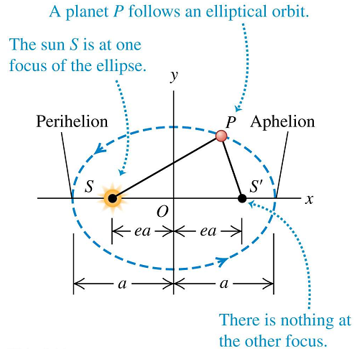
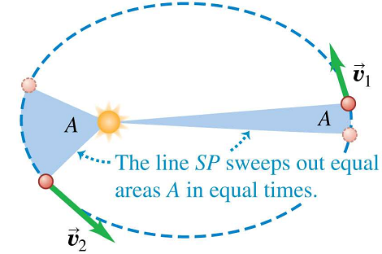
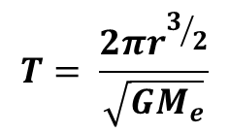
Keplers’s Law of Planetory Motion
The planets describes motion in elliptical orbit about the sun as a focus
The line joining the sun and each planet sweeps out equal areas in equal times (i.e constant period) due to conservation of angular momentum
The square of the period T is proportional to the cube of the radius of the ellipse of each planet i.e T² α r^{3.}
1st Law
2nd Law
$$T= \frac{2πr^{3/2}}{\sqrt{GM_{e}}}$$
3rd Law

Slide 4
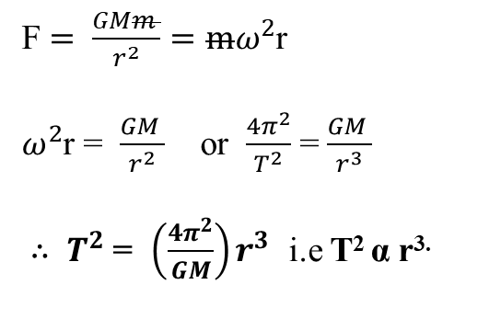
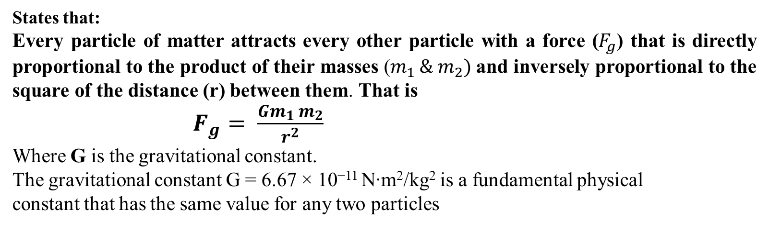
Newton’s Law of Universal Gravitation
States that:
Every particle of matter attracts every other particle with a force ($F_{g}$) that is directly proportional to the product of their masses ($m_{1 }{\& m}_{2})$and inversely proportional to the square of the distance (r) between them. That is
$F_{g}= \frac{Gm_{1 }m_{2}}{r^{2}}$
Where G is the gravitational constant.
The gravitational constant G = 6.67 × 10⁻¹¹ N∙m²/kg² is a fundamental physical
constant that has the same value for any two particles
Consider the sun of mass, M and a planet of mass, m, the gravitational force which provide the centripetal force is given by:
F $= \frac{GMm }{r^{2}}=mω^{2}$r
$ω^{2}$r = $\frac{GM }{r^{2}}$ or $\frac{4π^{2}}{T^{2}}$ = $\frac{GM }{r^{3}}$
$∴$ $T^{2}$ = $\left(\frac{4π^{2}}{GM}\right)r^{3}$ i.e T² α r^{3.}
This is Kepler’s 3rd law and it implies 2nd law since for a particular planet moving in an orbit, the radius r is constant

Slide 5
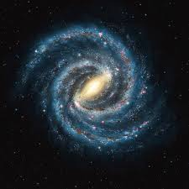
Gravitational Attraction
Our solar system is part of a spiral galaxy like this one, which contains roughly 10¹¹ stars as well as gas, dust, and other matter (mostly dark matter).
The entire assemblage is held
together by the mutual
gravitational attraction of all
the matter in the galaxy

Slide 6

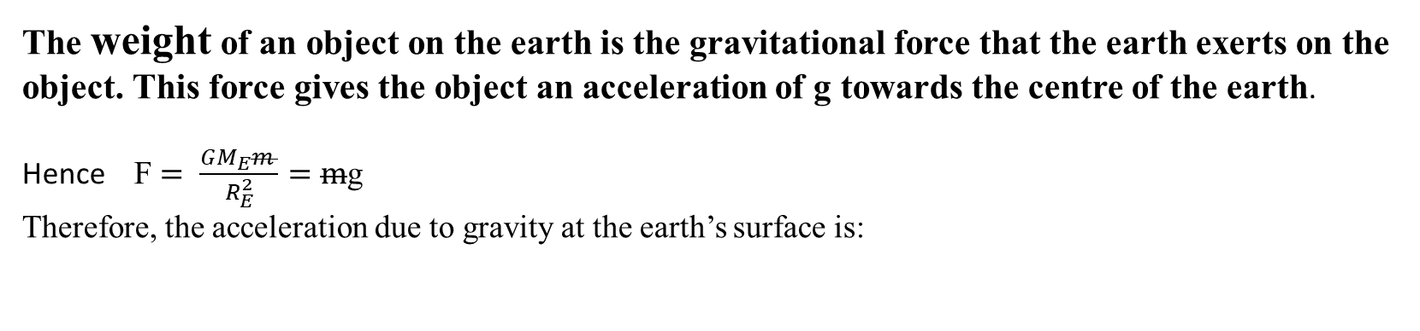
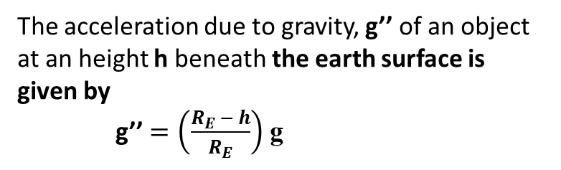
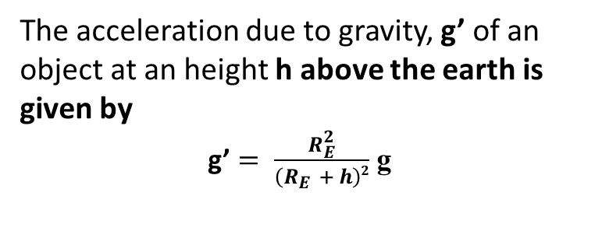

Weight and Acceleration Due to Gravity
The weight of an object on the earth is the gravitational force that the earth exerts on the object. This force gives the object an acceleration of g towards the centre of the earth.
Hence F $= \frac{GM_{E}m }{R_{E}^{2}}=m$g
Therefore, the acceleration due to gravity at the earth’s surface is:
$$∴ g ∝ \frac{1}{r^{2}}$$
This explains why g is not constant all over the world (It is more at the pole than at the equator. The average value of g is 9.8 ms⁻²
The acceleration due to gravity, g’ of an object at an height h above the earth is given by
g’ $= \frac{R_{E}^{2}}{\left(R_{E }+ h\right)2}$ g
The acceleration due to gravity, g’’ of an object at an height h beneath the earth surface is given by
g’’ $=\left(\frac{R_{E }− h}{R_{E}}\right)$ g

Slide 7
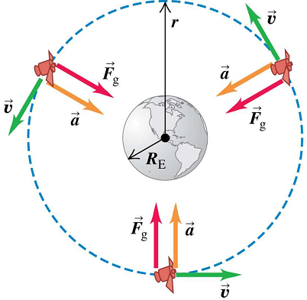

Orbits Round the Earth
Satellites are objects that revolve other objects. For example, the moon around the earth is a natural satellite.
The force due to the earth’s gravitational attraction provides the centripetal acceleration/ force that keeps a satellite in orbit.

Slide 8
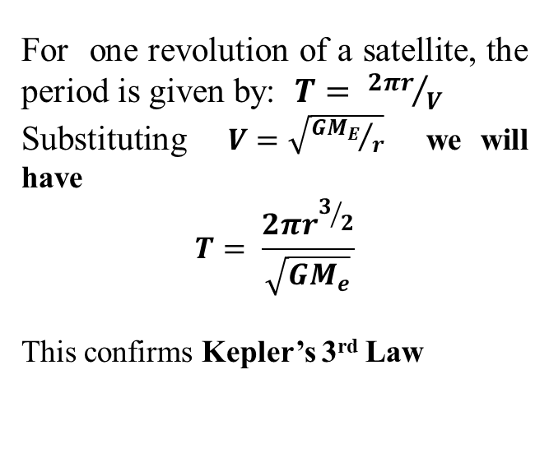
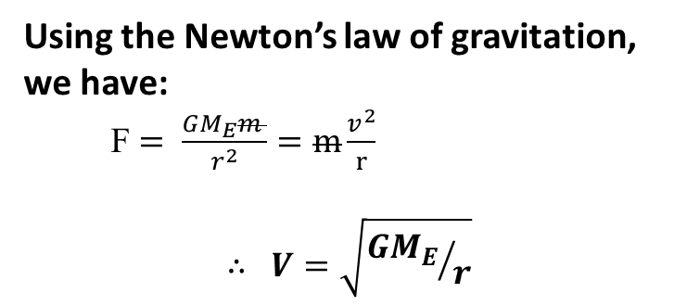
Using the Newton’s law of gravitation, we have:
F $= \frac{GM_{E}m }{r^{2}}=m\frac{v^{2}}{r}$
$$∴ V=\sqrt{{GM_{E}}/r}$$
For one revolution of a satellite, the period is given by: $T= {2πr}/V$
Substituting $V=\sqrt{{GM_{E}}/r}$ we will have
$$T= \frac{2πr^{3/2}}{\sqrt{GM_{e}}}$$
This confirms Kepler’s 3rd Law
For a circular orbit of radius r , the Speed, V of a satellite is just right to keep its distance from the center of the earth constant.
A satellite is said to be parked if its period is 24 Hrs ( the time taken by earth to complete one rotation

Slide 9
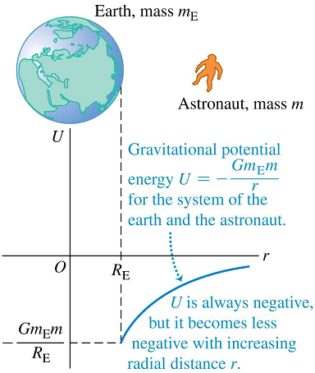
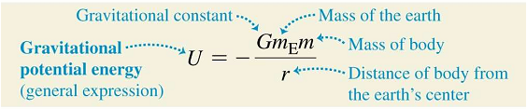
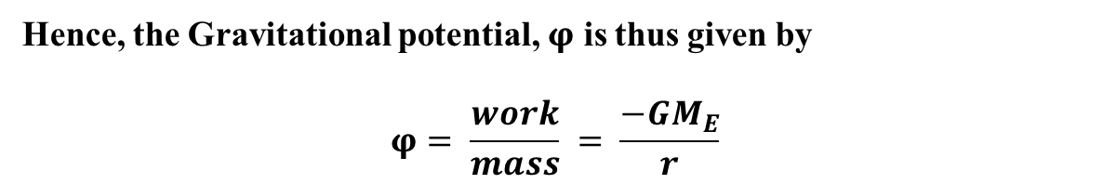
Earth’s Gravitational Potential Energy
The earth’s gravitational potential energy at any point in the earth gravitational field can be defined as the total work done per unit mass on a body to move it from the point which is at a distance r from the center of the earth to infinity (where F_{g} = 0)
Hence, the Gravitational potential, $φ$ is thus given by
$$φ= \frac{work}{mass} = \frac{−GM_{E}}{r}$$
U depend on distance, r

Slide 10
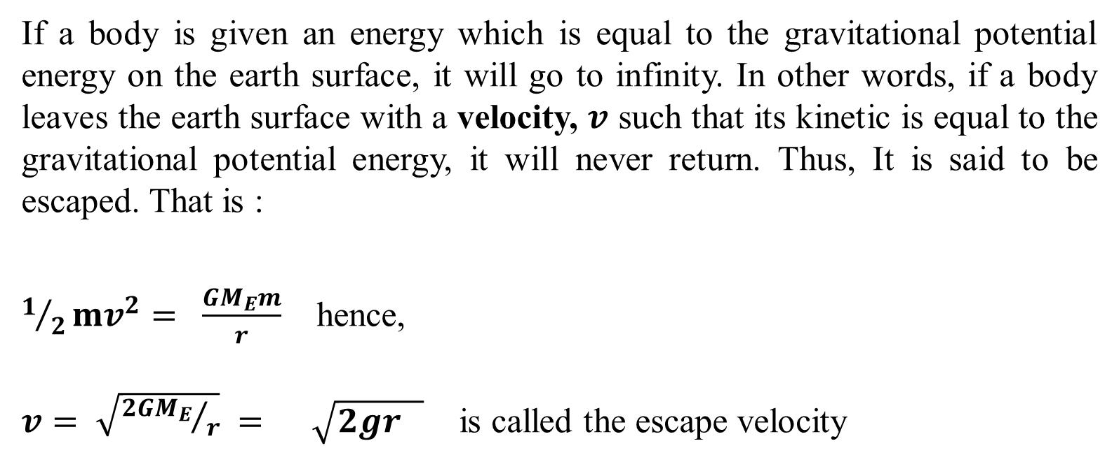
Escape Velocity
If a body is given an energy which is equal to the gravitational potential energy on the earth surface, it will go to infinity. In other words, if a body leaves the earth surface with a velocity, $v$ such that its kinetic is equal to the gravitational potential energy, it will never return. Thus, It is said to be escaped. That is :
$1/2mv^{2}= \frac{GM_{E}m}{r}$ hence,
$v= \sqrt{{2GM_{E}}/r} = \sqrt{2gr }$ is called the escape velocity

Slide 11
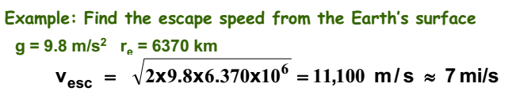
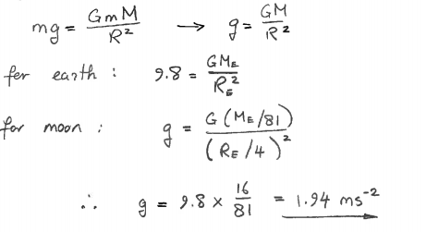
Example:
The mass of the moon is about one eighty-first, and its radius one-fourth, that of the earth. Calculate the acceleration due to gravity on the surface of the moon.
Solution

